Slide 1


Library Orientation for Students

Slide 2
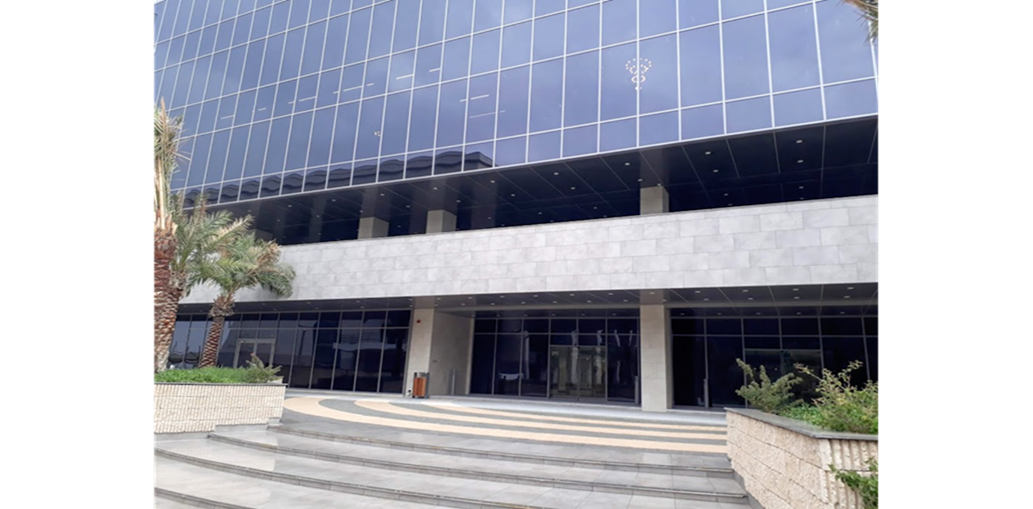



Welcome to the AIC library
Librarian
Nobathembu Letsoenyo
noba@aiu.edu.kw
Tel Extension - 3232
Library Assistant
Manuelina Gutierrez
m.gutierrez@aiu.edu.kw
Tel Extension - 3233

Slide 3
Background to the AIC library
Occupies two floors of the B-Building
Print books are on the second floor
Third floor is mainly collaborative spaces
Mixture of collaborative and individual spaces

Slide 4
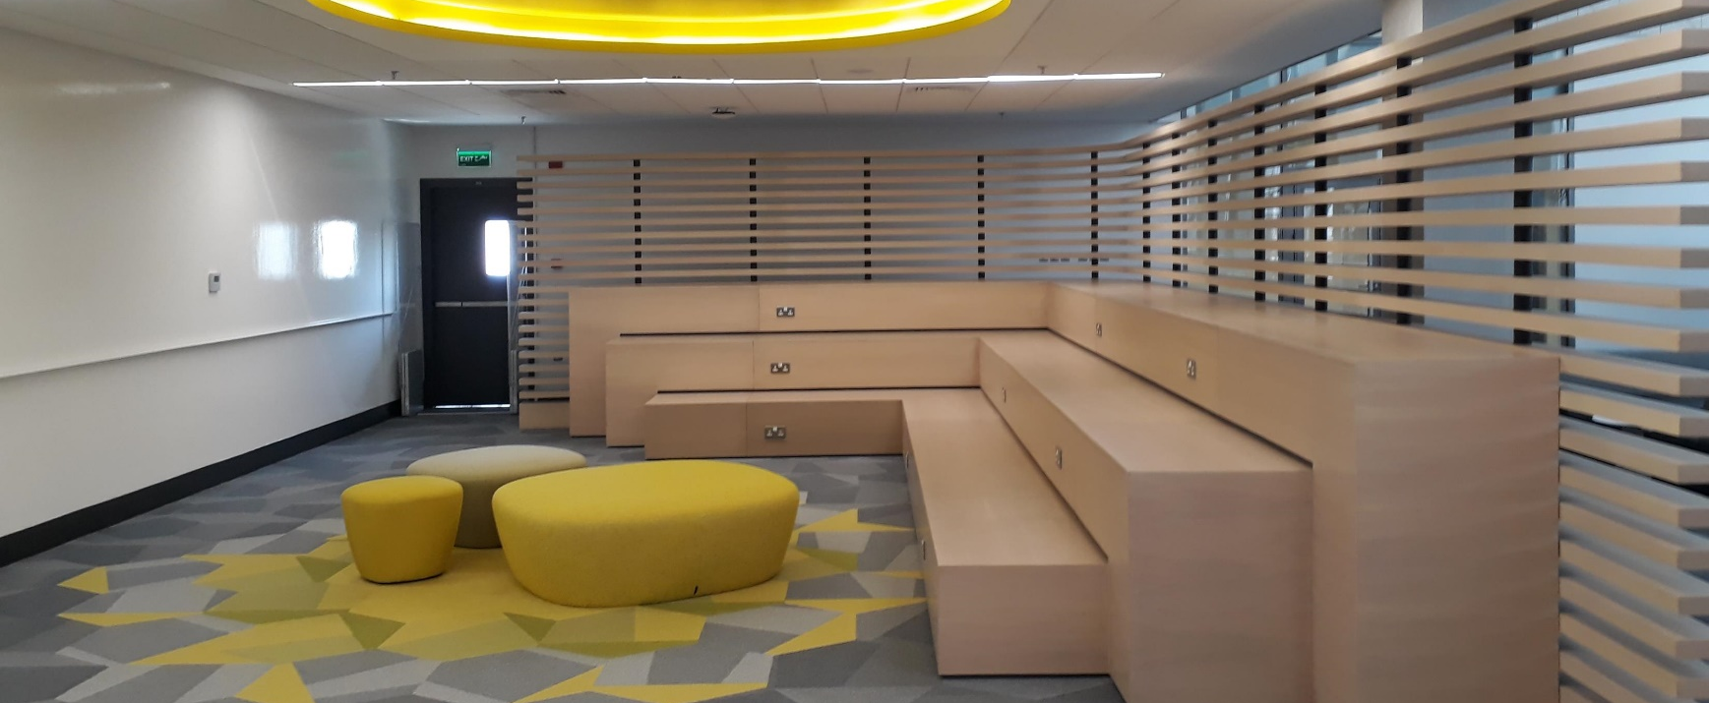
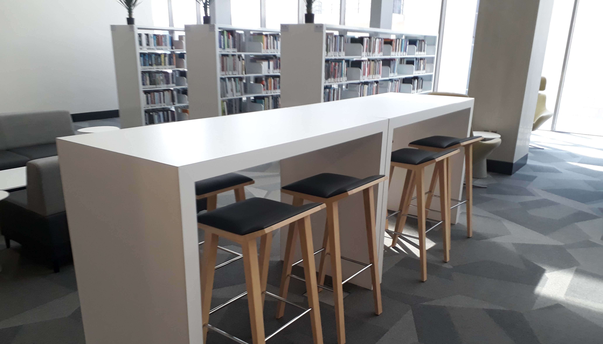
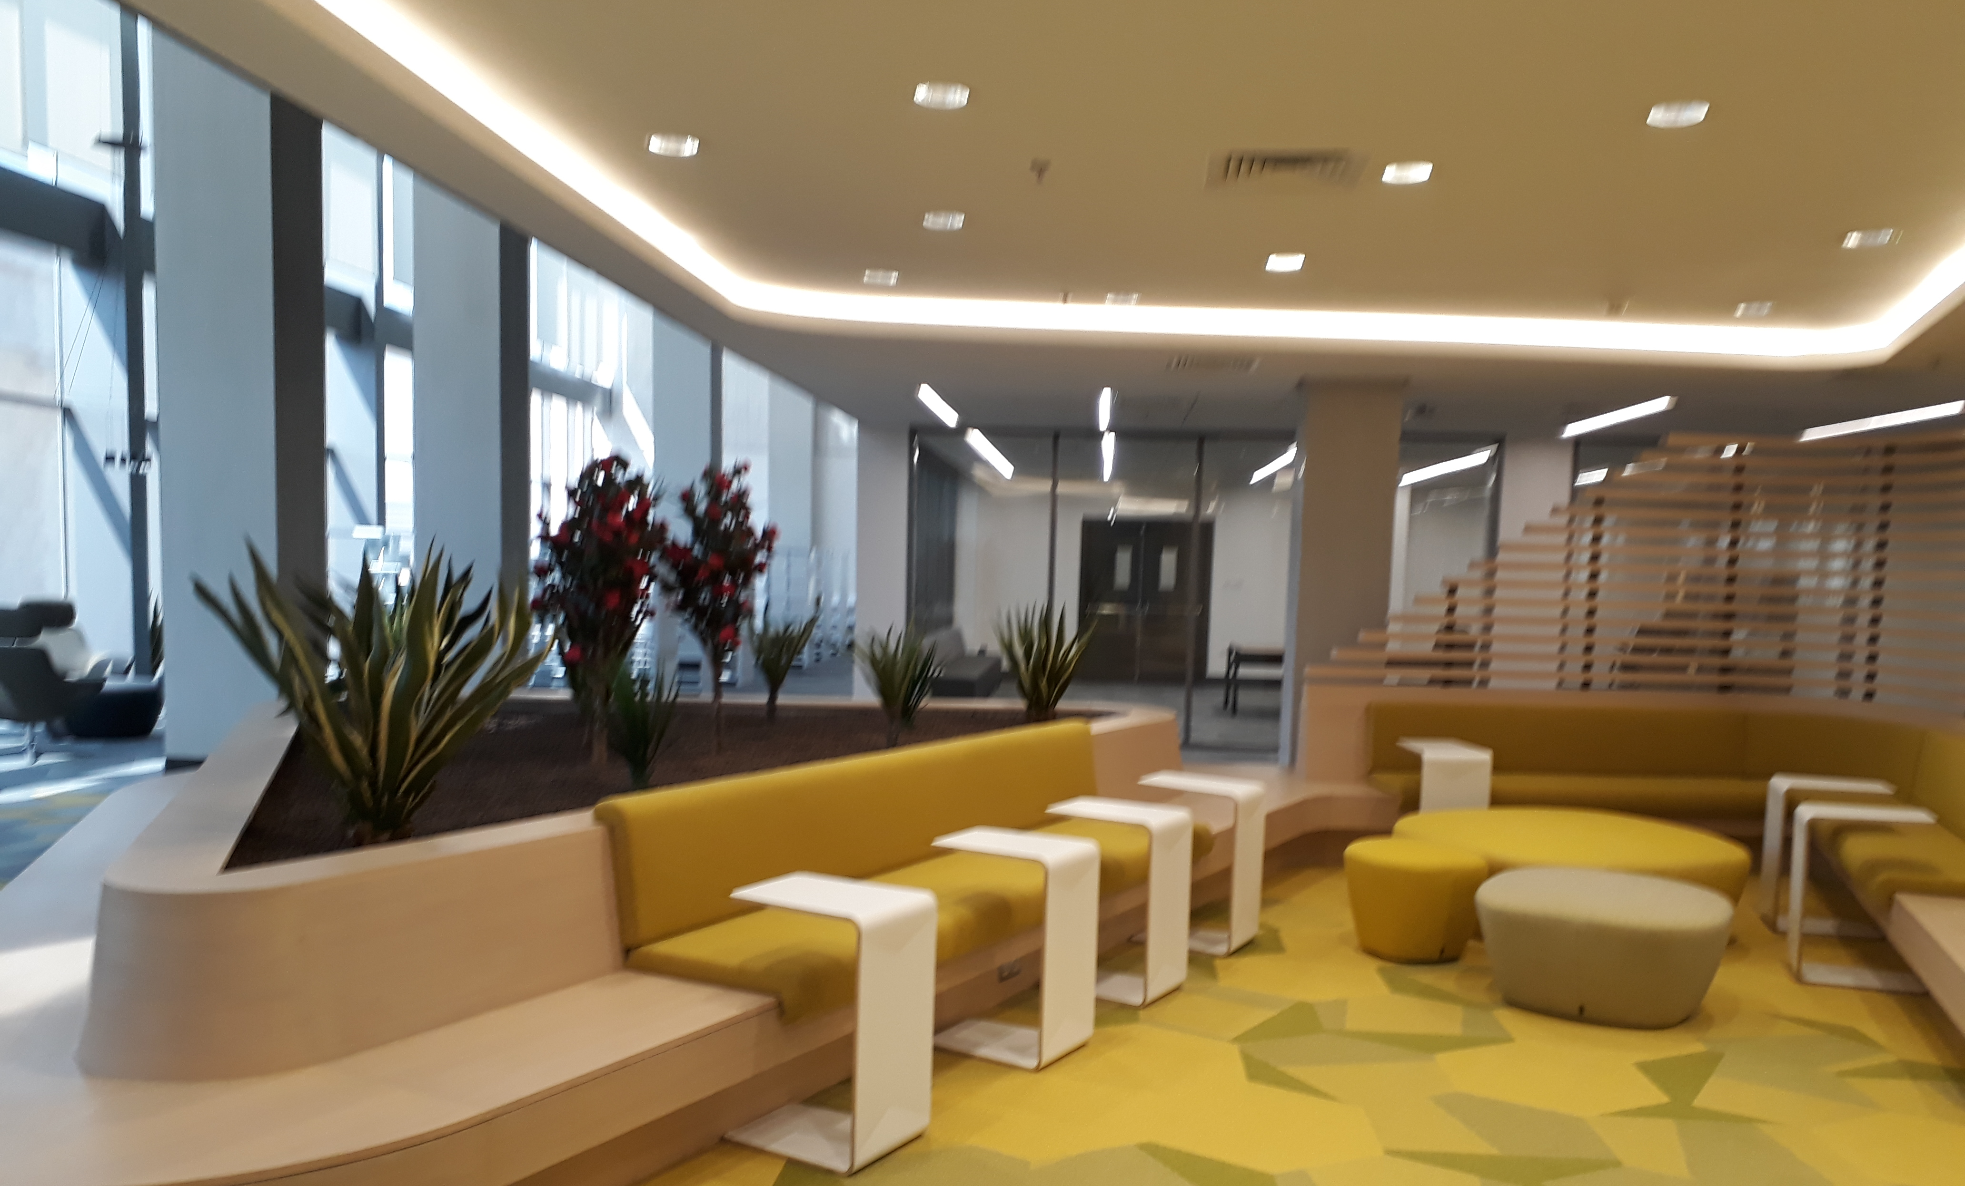
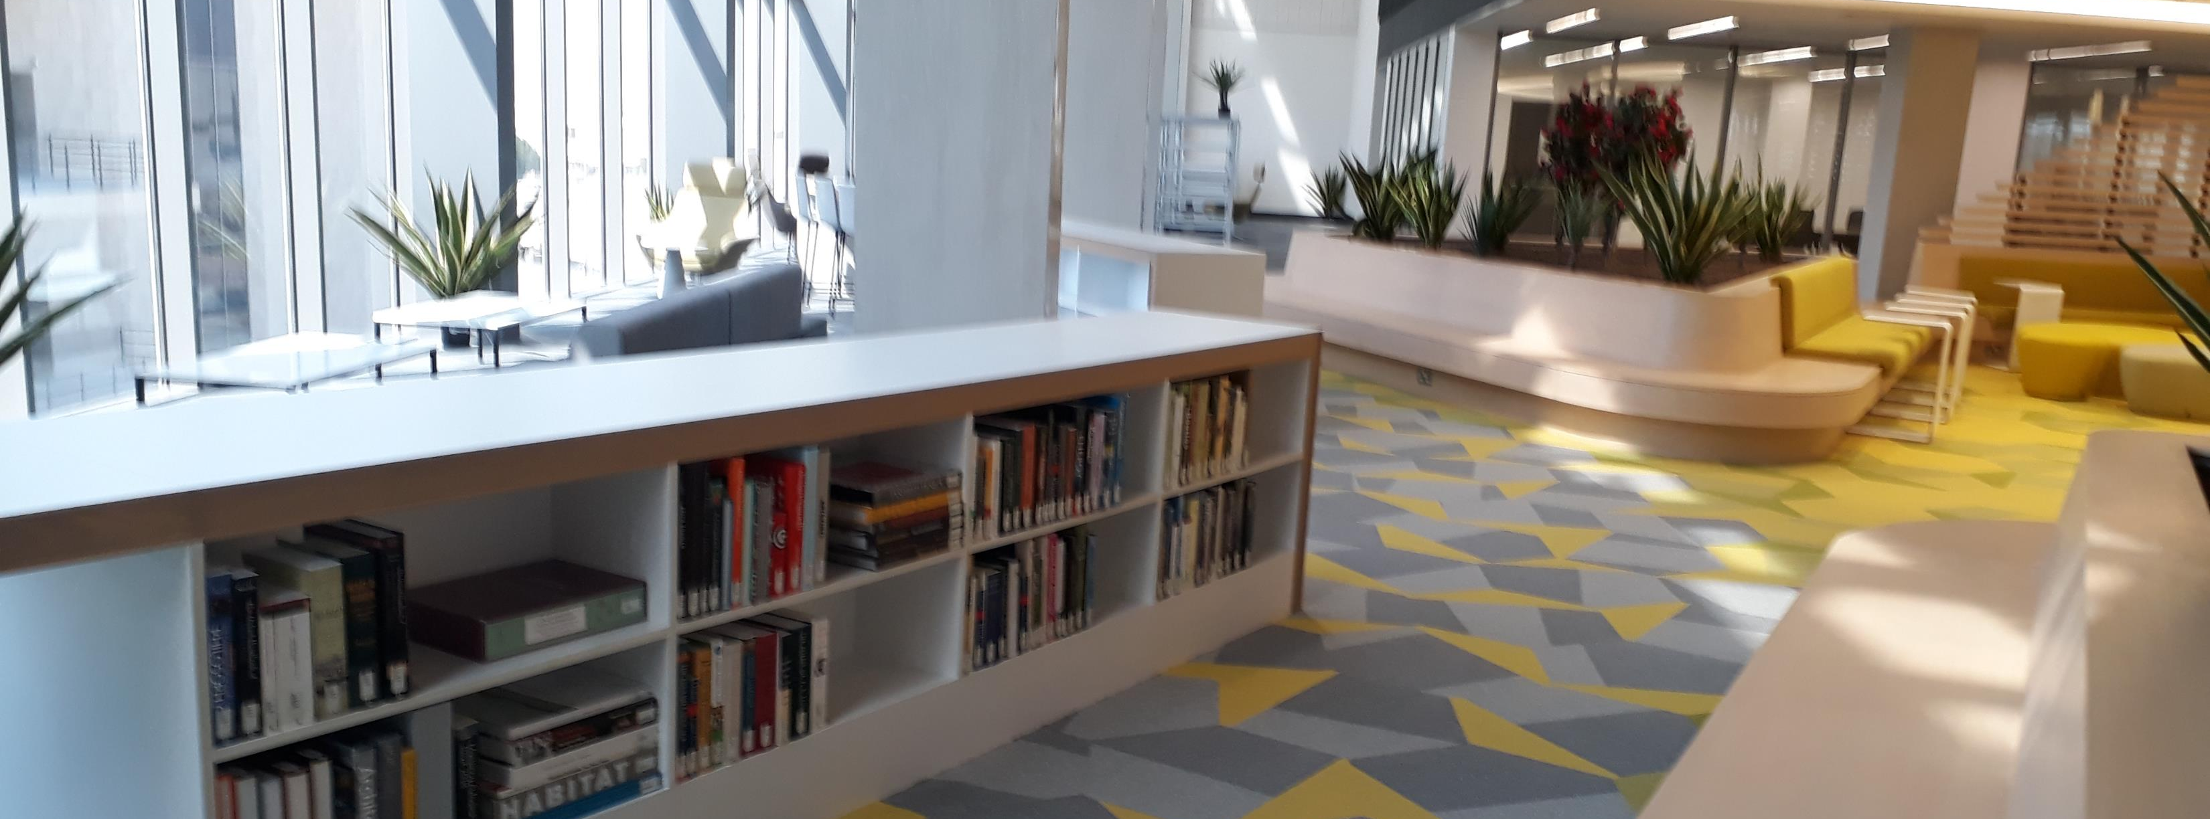

Slide 5
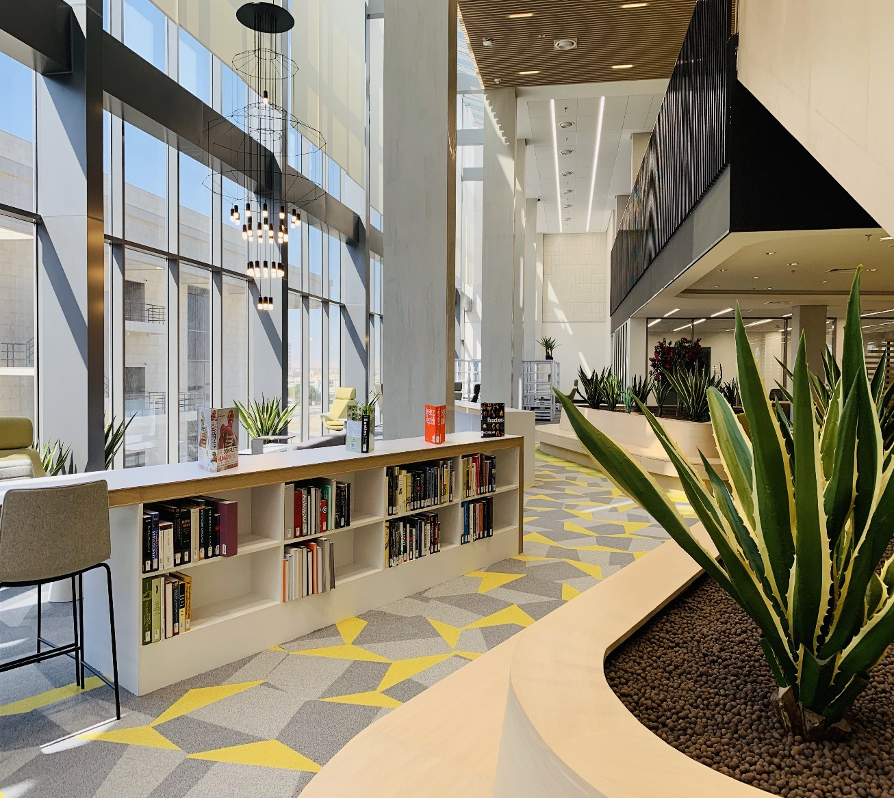

Library Print Collection
Student Loan Privileges
All students can borrow books and other library materials
5 Library Items for 15 days – whatever the format
Reference material is to be used inside the Library only
Library users are responsible for all items checked out under their name
Books set apart by Faculty as course reserve can only be used in the library or overnight
Students can suggest library titles through the Sierra system

Slide 6

Electronic Resources - Ebscohost

Slide 7
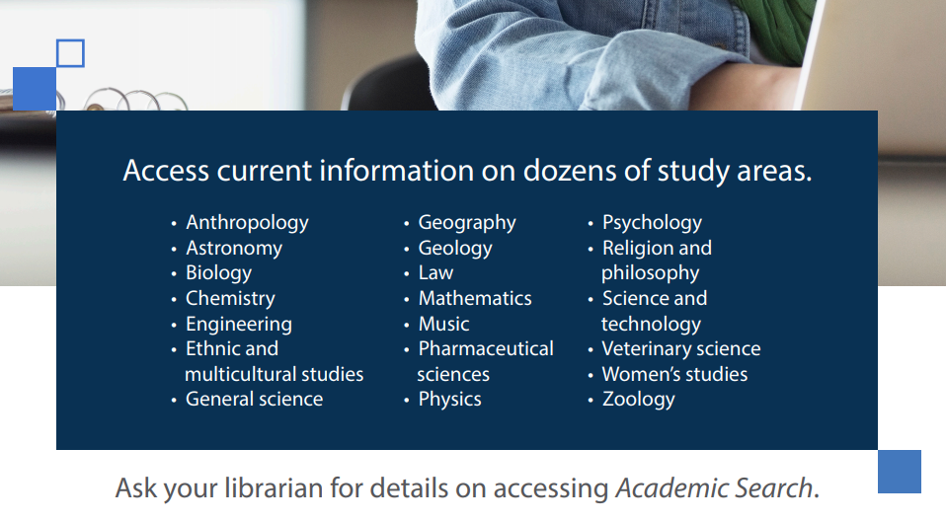

Slide 8
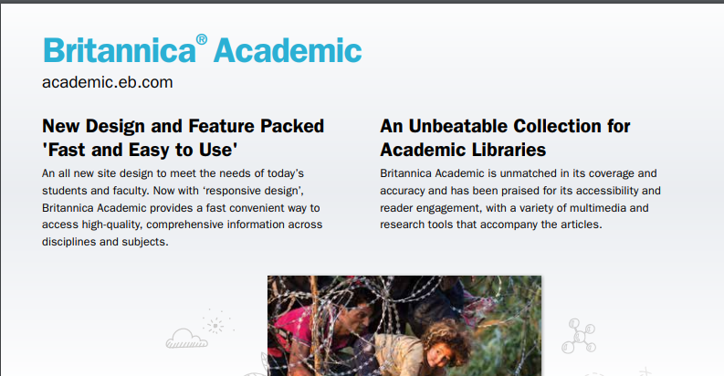

Slide 9
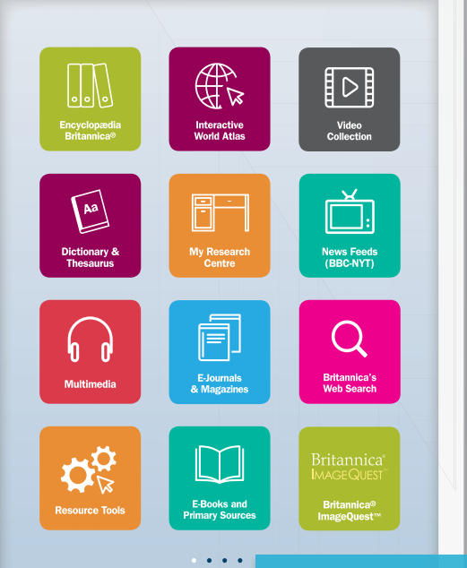

Slide 10
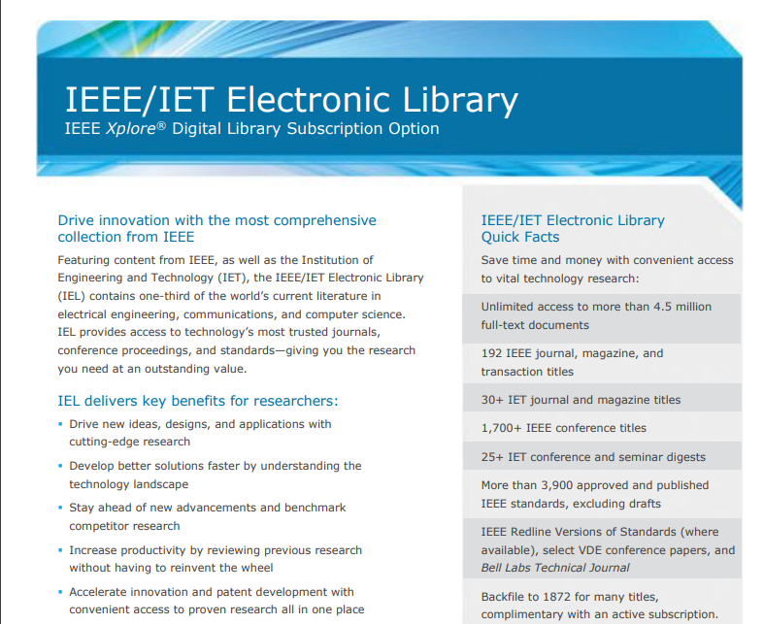

Slide 11
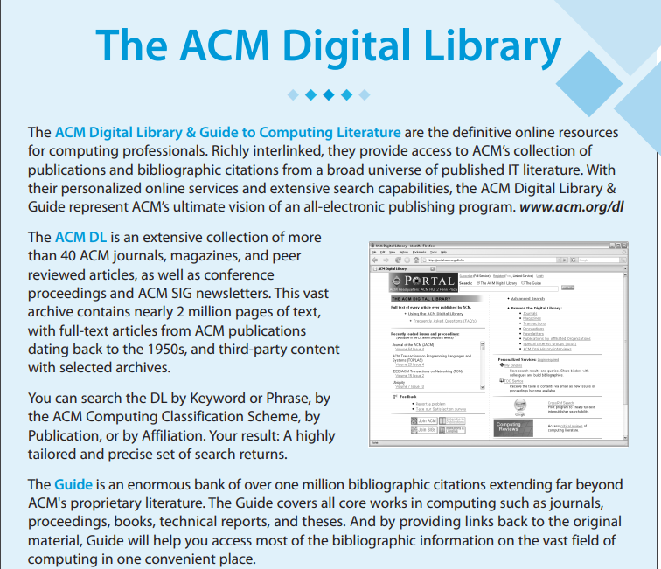

Slide 12
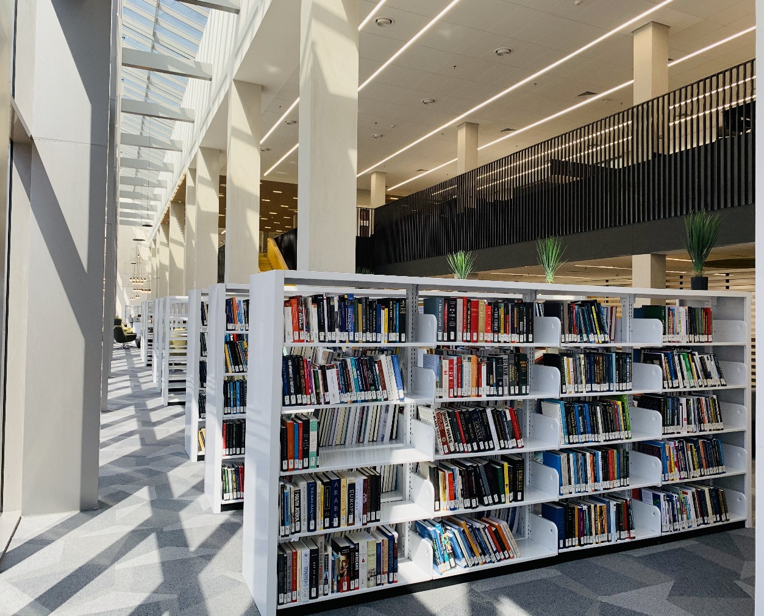
Basic Library Services
The Circulation service provides issue-return-renewal-reservation service
Renewals - Materials must be renewed on or before the due date
Any book can be renewed if there is no hold or recall
Holds - Holds on items will be placed upon request
The user will be notified when the requested material is available for check out

Slide 13
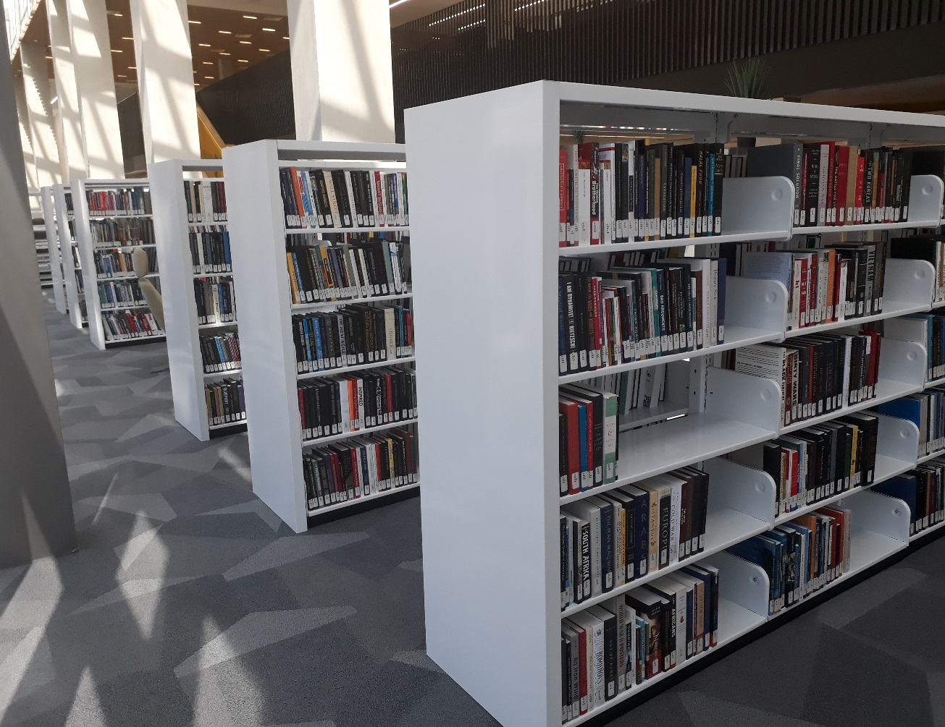
Basic Library Services
Overdues - overdue materials will be charged a fine from the first day following the due date
Lost items - user will be charged the cost of that item plus a processing fee (10 kwd)
Damaged items - users will also be charged for damaged materials depending on the extent of the damage
Water damaged or oil damaged books must be paid for in full – they cannot be repaired
Fines- for any unpaid fines, the student will receive one fine notice after the item is returned.
If not paid, fines will be added to the student’s account

Slide 14
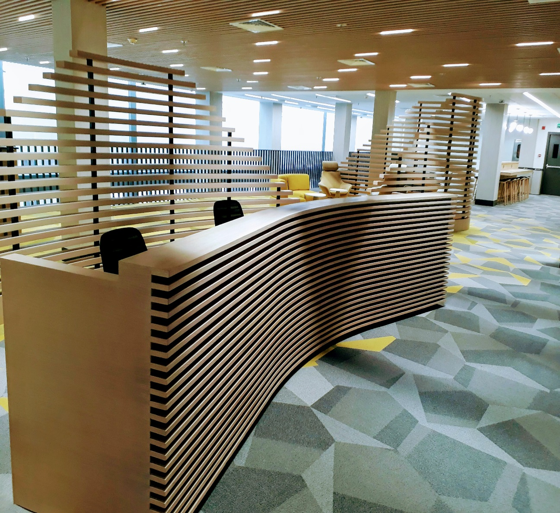
Library services to Students
Help orient students to the library facilities and services
Library Instruction provision, integrated into student learning
We help students understand how information systems are organized and how to access relevant information for assignments. (Database; Journal; Article)
We offer Information Literacy workshops to assist in research skills training and producing scholarly research projects
Assistance with printing and copying services for projects

Slide 15
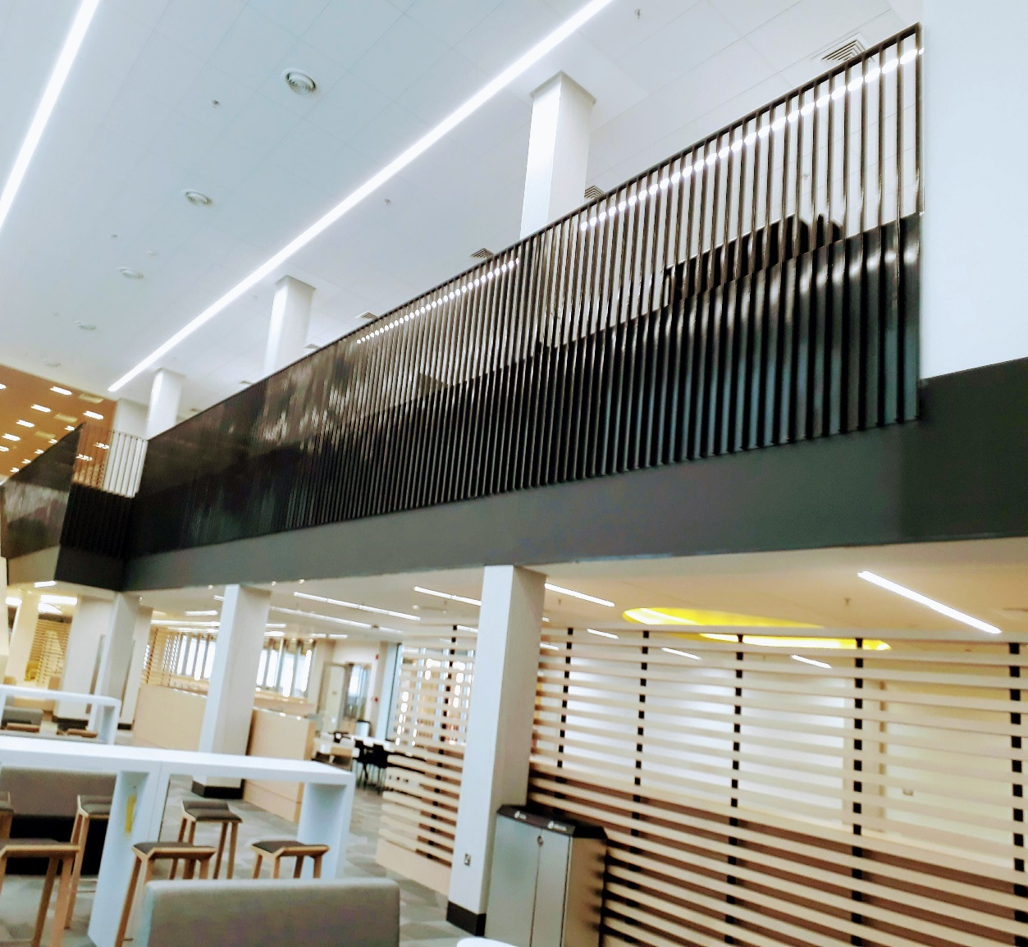
Library services to Students (cont…)
Research assignment assistance on request – we assist you to understand what the assessment requires you to do
Learning resources location – we find the best resource to use for any given assessment in both print and electronic
Leisure reading to improve academic reading fluency – we undertake to support extra curricular reading through student - centered reading activities
We support course modules through CANVAS for a seamless learning experience
Enable you to reserve a Group Study Room to collaborate with your peers

Slide 16






Fiction @ the library
Young adult leisure reading collection
Helps develop reading fluency
Can be taken out
Students can suggest suitable titles

Slide 17
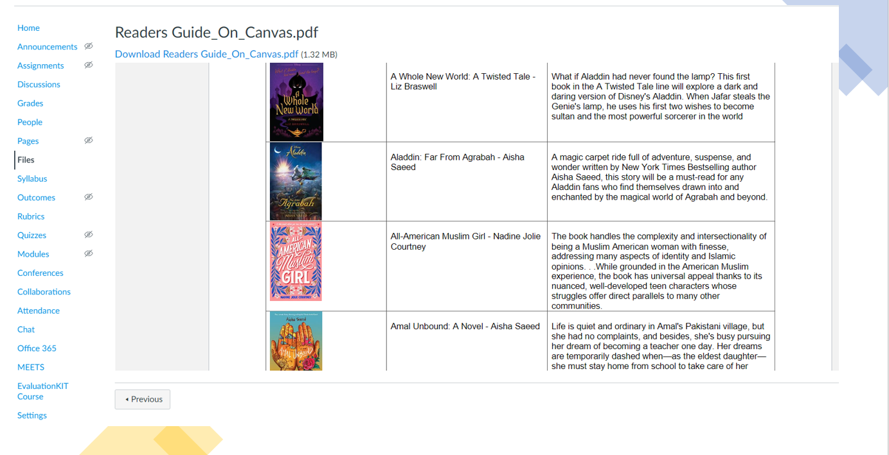

Slide 18

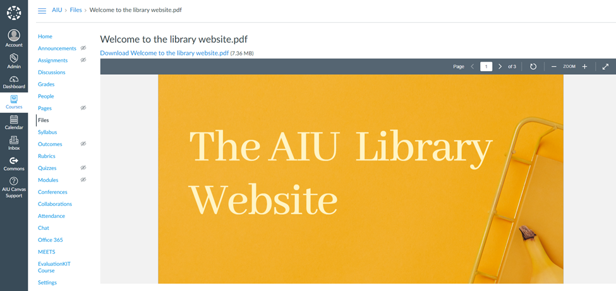
AIU Library on Canvas
14 Library modules on Canvas to support all students
Easy to understand “How to” files
Links to video content relevant to module
Information on how to avoid plagiarism, correct referencing & citation using the Harvard method
How to use library subject databases
Using Turnitin to check for plagiarism on your assignment before submitting
English Foundation Program module on Canvas

Slide 19
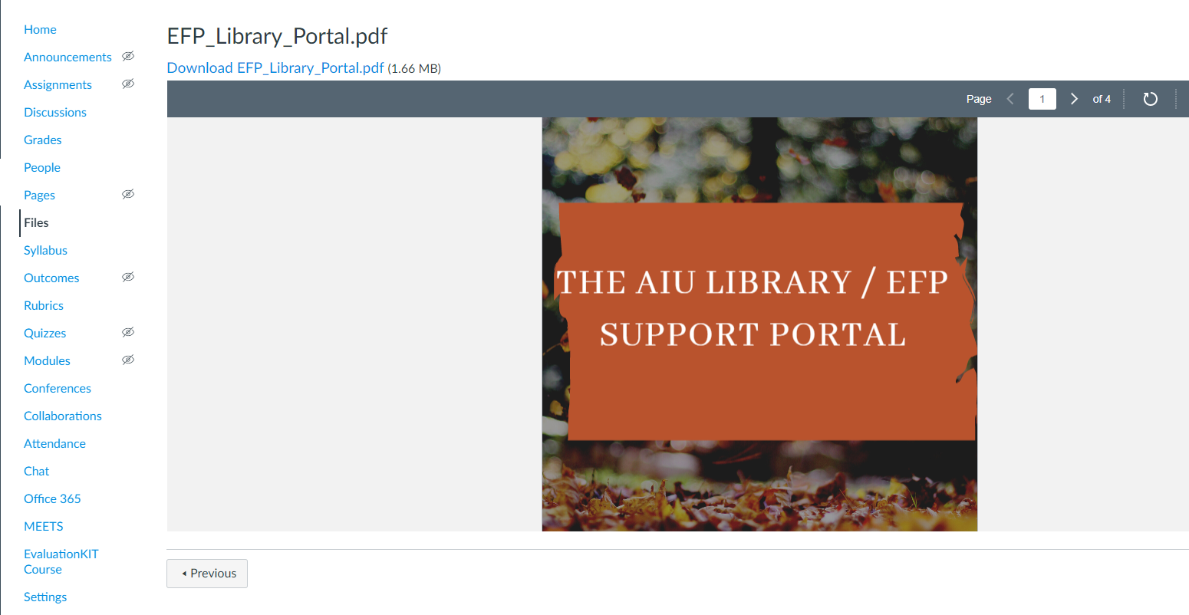

Slide 20
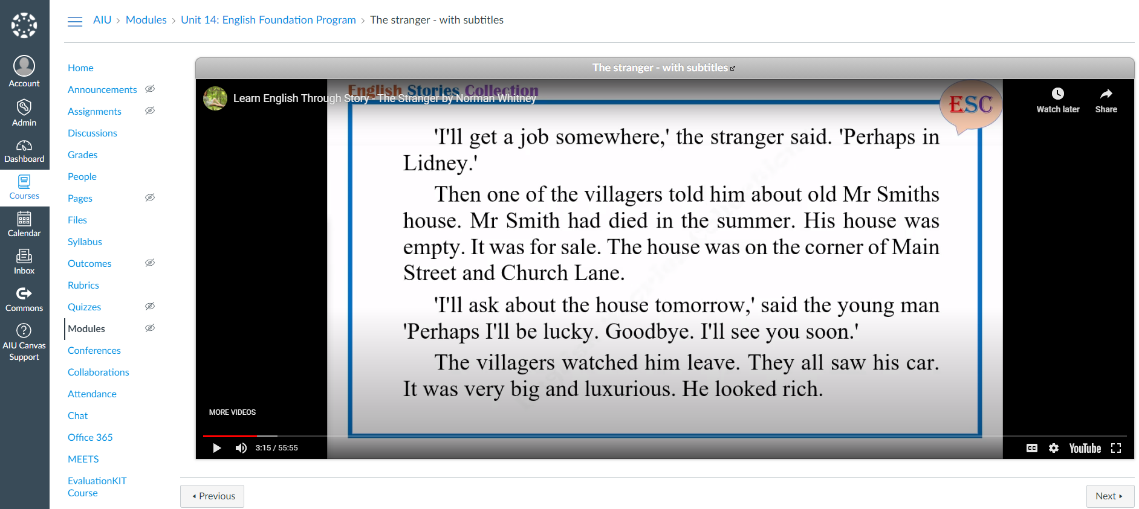

Slide 21


